Slide 1
Reporting and Visualization Tools
Kerry Nakayama

Slide 2






Visualization Tools

Slide 3


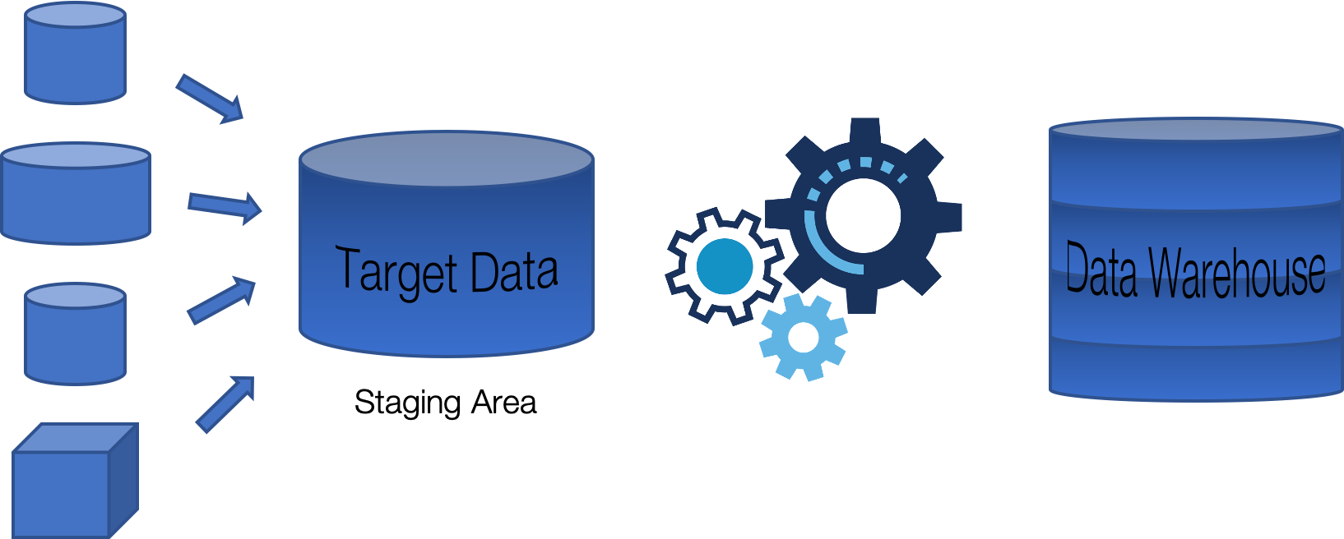


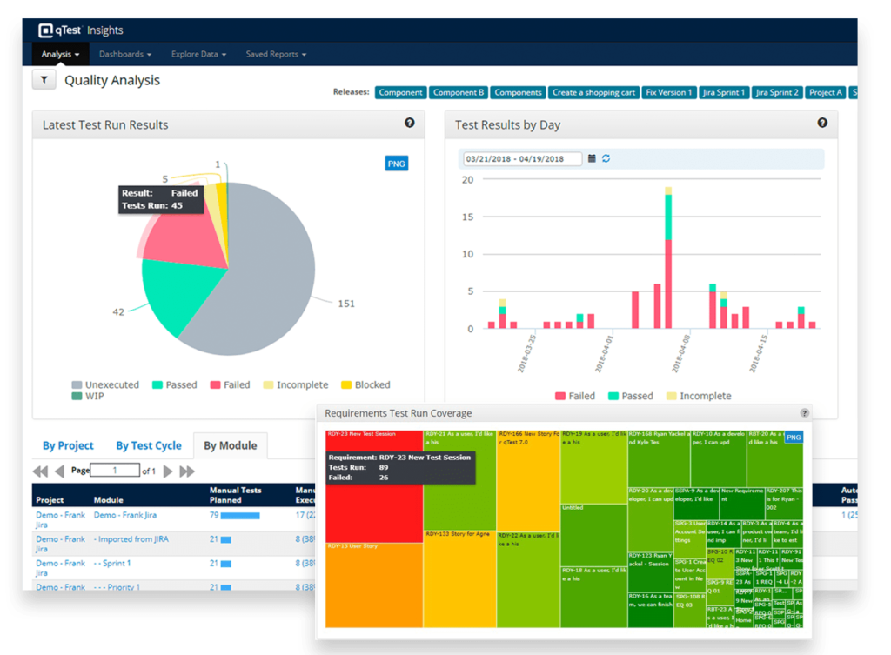
Schema and Warehouse Setup
Reporting Schema

Slide 4
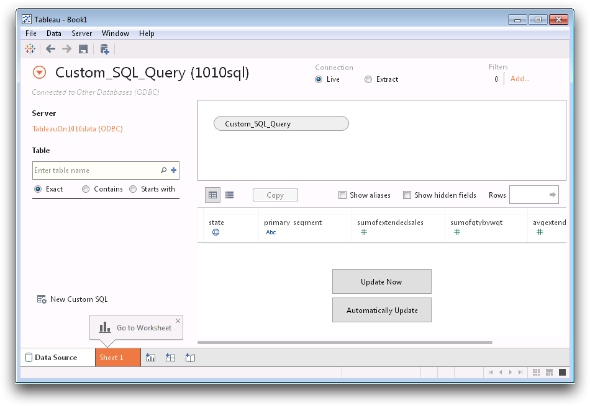
Tableau Custom SQL
Tableau allows you to connect any DB or Schema directly
Write custom SQL as if you are querying the DB directly
What could go wrong with this?
4
Notes:
Live connection
Every time a report is run it will have to run the query again…. So we have cached queries
What about filters when the user is changing a filter… no longer the same query
This can get very expensive depending on how active your tableau users are
If connecting to a huge table reports can take forever to run
Depending on how normalized the table is in prod you may need multiple connections to get the details that you need
Now connecting all these tables in tableau can take forever to run
This is problem I dealt with at many companies
Email the reports
So why not create an extract
Runs the code one time in the morning and creates an extract of the data… no longer have expensive queries running for all the people (could be hundreds)
New problem
No version control
In the notebook is deleted all the code is lost
No documentation
So how to fix this?/

Slide 5
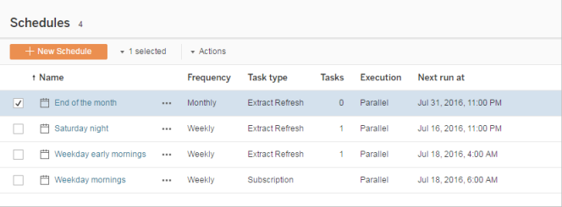
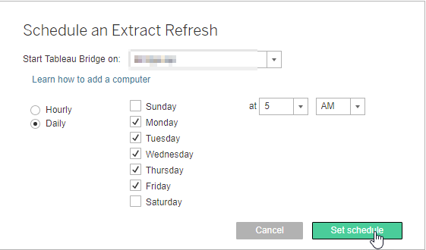
Extract Refresh Scheduler
Tableau allows you to schedule refreshes
Sending Reports through Tableau
Again What could go Wrong?
5
Notes:
Again major problem everything is still in tableau

Slide 6





Mini Breakout Lab
You are the Director of Business Intelligence
Create a plan…
How you would pull the custom SQL out of Tableau?
Where would you put it?
Would you keep live data or extracts?
Will you use any tools?
In a perfect world how would you control reports
6

Slide 7
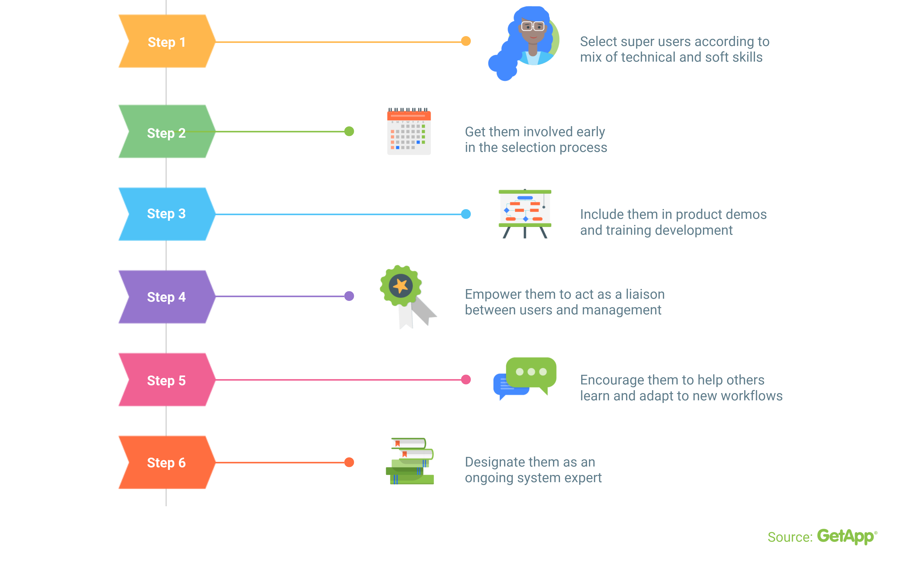
How to Implement a New Plan
Notes:
It needs to be a cultural change

Slide 8




Reporting Schema
What is a Reporting Schema?
Pull the queries out of Tableau and into a repository
can help with this!
Schedulers
Reporting Schema
8

Slide 9
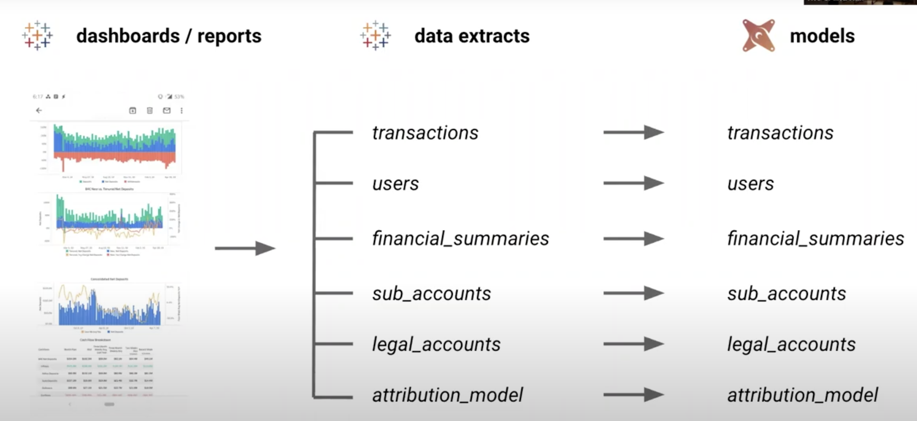
Connecting it all
Notes:
One to one model of extract to model

Slide 10
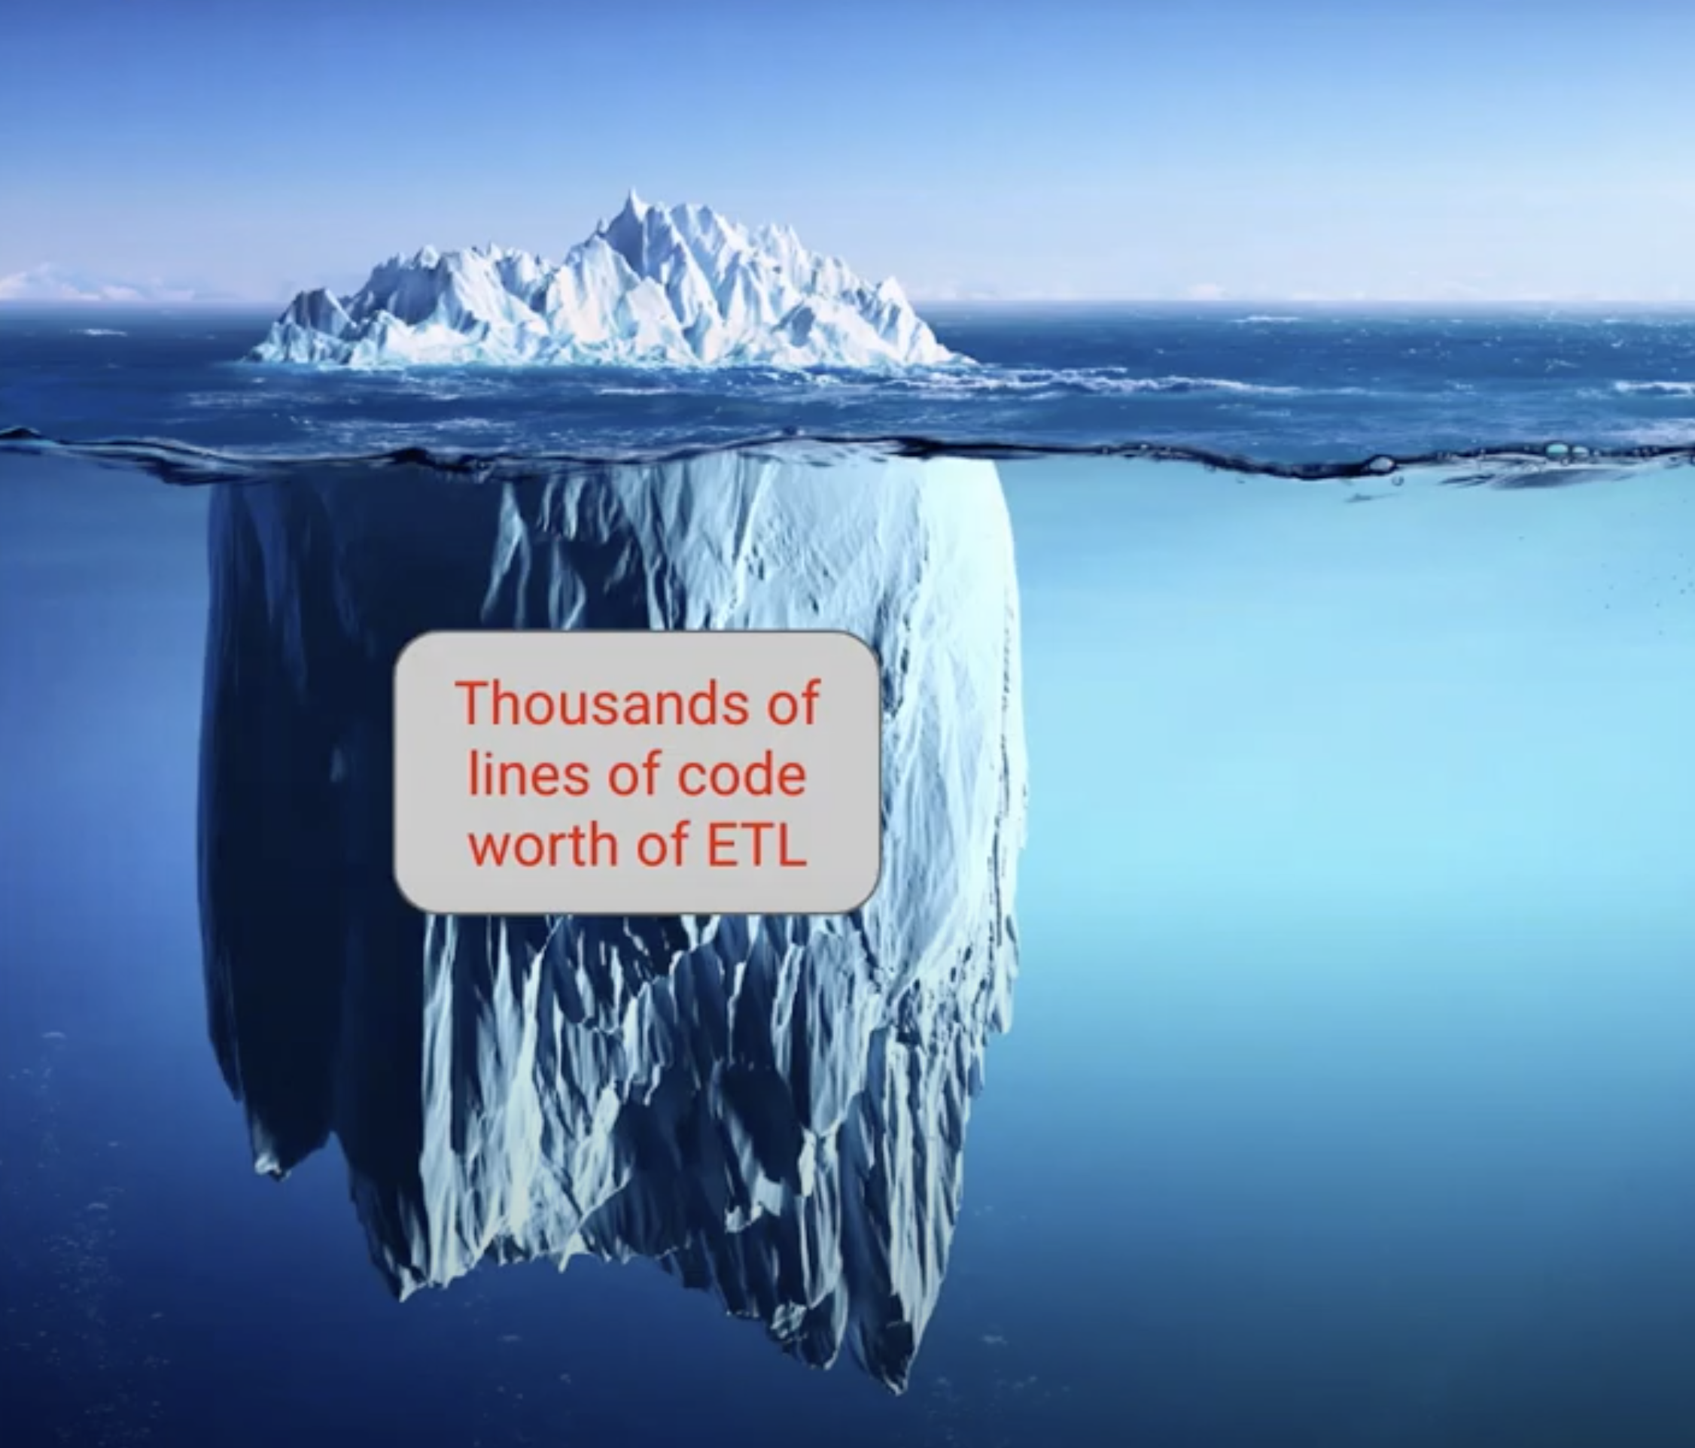
What’s Really Under the Hood

Slide 11
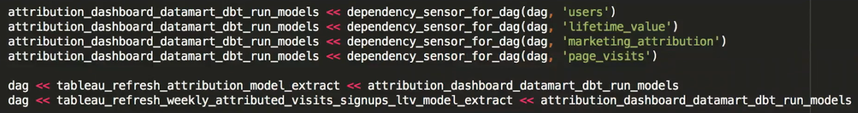
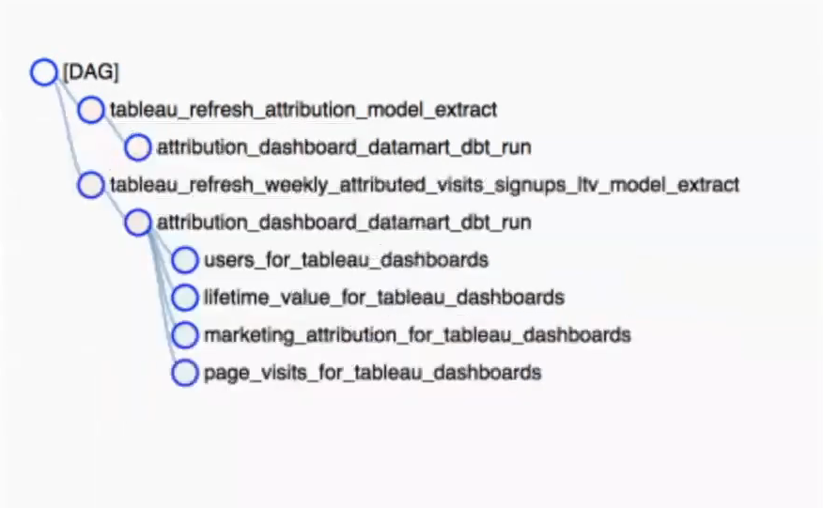
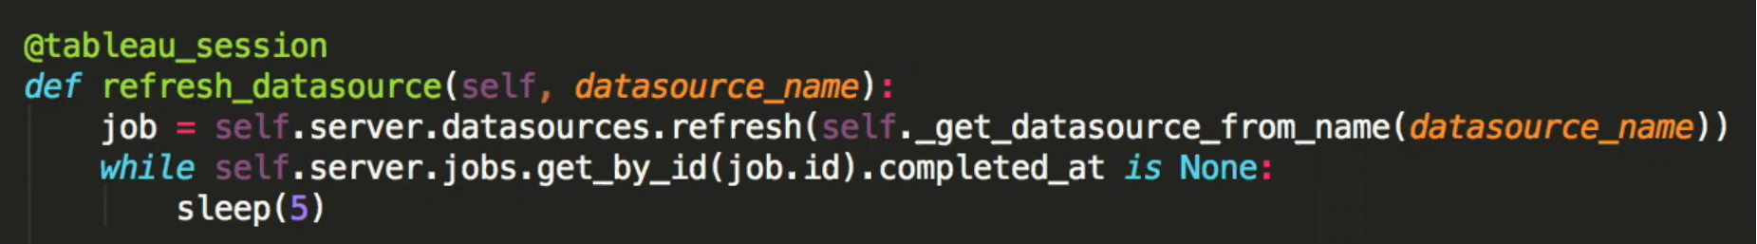
DAGs
Notes:
Directed acyclic graph

Slide 12

Optimizing Reporting Schema
Best Practices
Separate extracts for different date groupings
Limit the columns
Only run extracts when they need to be run
Make filters human readable
Limit functions in Tableau
Custom SQL should be Select * from Table with maybe a date filter
Performance tuning often
Test and iterate
12

Slide 13
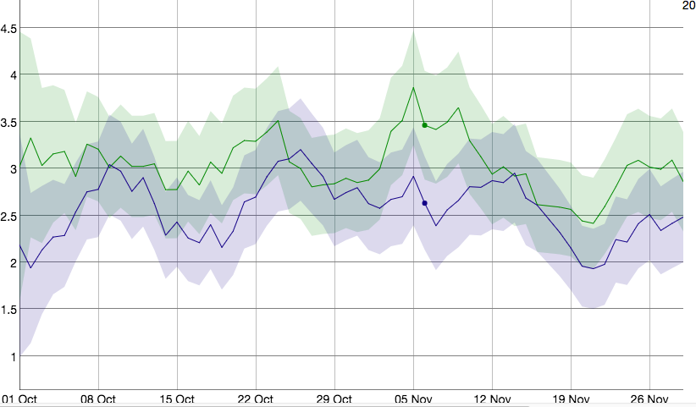
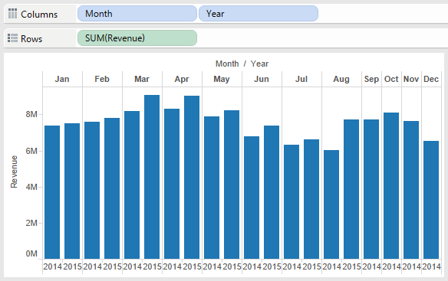
To Pre-cache or To Not Pre-cache?
When to use live data
Examples of live data
DAU
Tracking current event compared to plan
Fraud
When to pre-cache
Examples of cached data
Yesterdays numbers
MoM, WoW, DoD comparisons
Hitting plan
13

Slide 14

Reporting Style Guide
Limit the number of views in a Dashboard
Encourage exploration through filters
Only show filters that are relevant
Use color and highlighting to emphasize the data
Don’t have the double scroll
Stay away from Fake Media Charts
Leverage the most viewed spots
MAKE REPORTS EASY TO UNDERSTAND IN UNDER 5 SECONDS
14

Slide 15

Confused? ASK QUESTIONS

Slide 16
Break & Lab 9
Notes:
DBT working session

